Slide 1

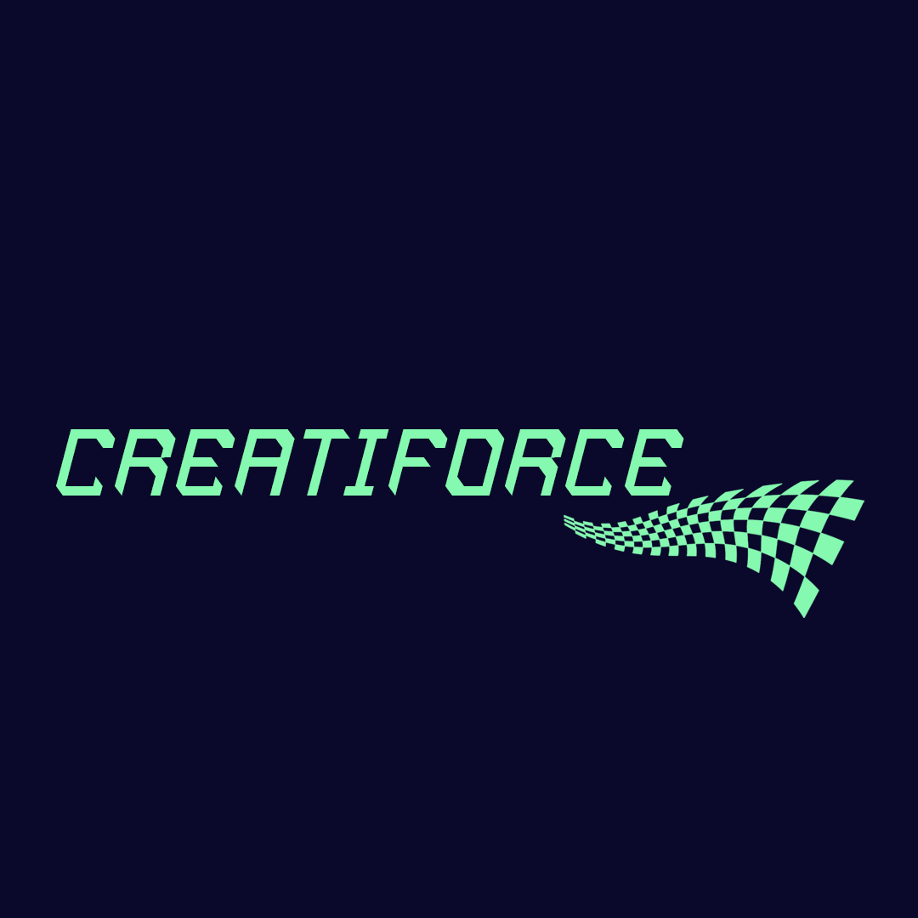

Final Presentation

Slide 2


TABLE OF CONTENT
Problem
Solution
Marketing opportunity
Business model
Competitive landscape
Go to market strategy
Financial projections

Slide 3
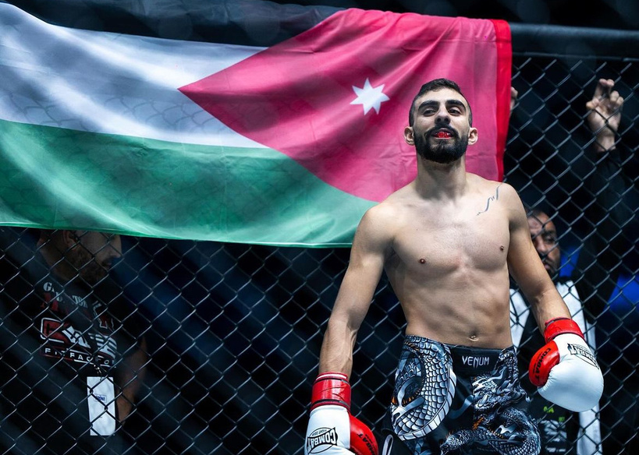
ABOUT THE USER
ABOUT THE USER
Rakan, a 20-year-old professional fighter and boxer, thrives on competition and intense gym training. His dedication is fueled by the adrenaline of the ring and his constant pursuit of improvement by studying legendary fighters.
Dedicated
competitive
strategic
passionate
RAKAN
PROBLEMS
GOALS AND NEEDS
20 years old
professional fighter
His problem is that he finds it time-consuming to use protein jars and scoops because he has a lot of classes to train and needs to go to his own training as well.
He wanted something that would help him reduce waste of the product and save time.

Slide 4



Plastic waste
Problem Statement
Mismanagement
Packaging Sector

Slide 5
problem
01
02
03
04
450 million tones of plastic
50% of plastic waste are in packaging
225 billion tones of plastic
3% of the 162 billion are for gym supplements

Slide 6

STATISTICS
6.75
6.75 million tons of plastic produced from gym supplements yearly

Slide 7
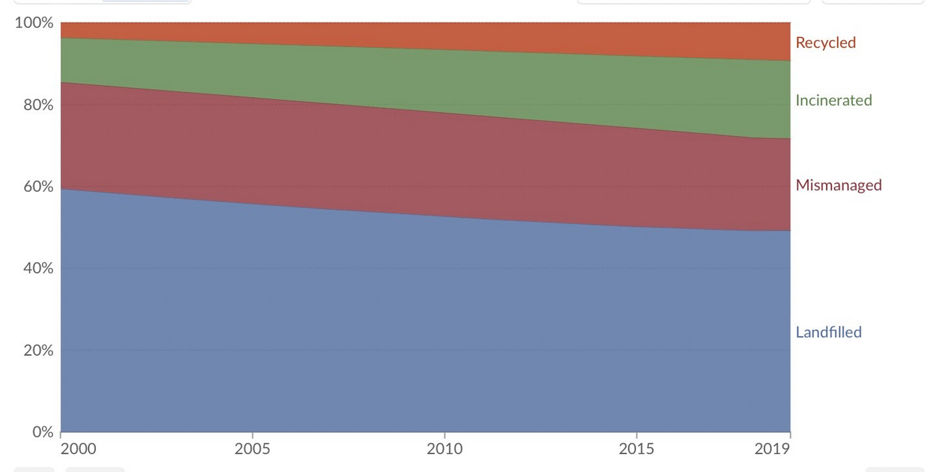

Slide 8
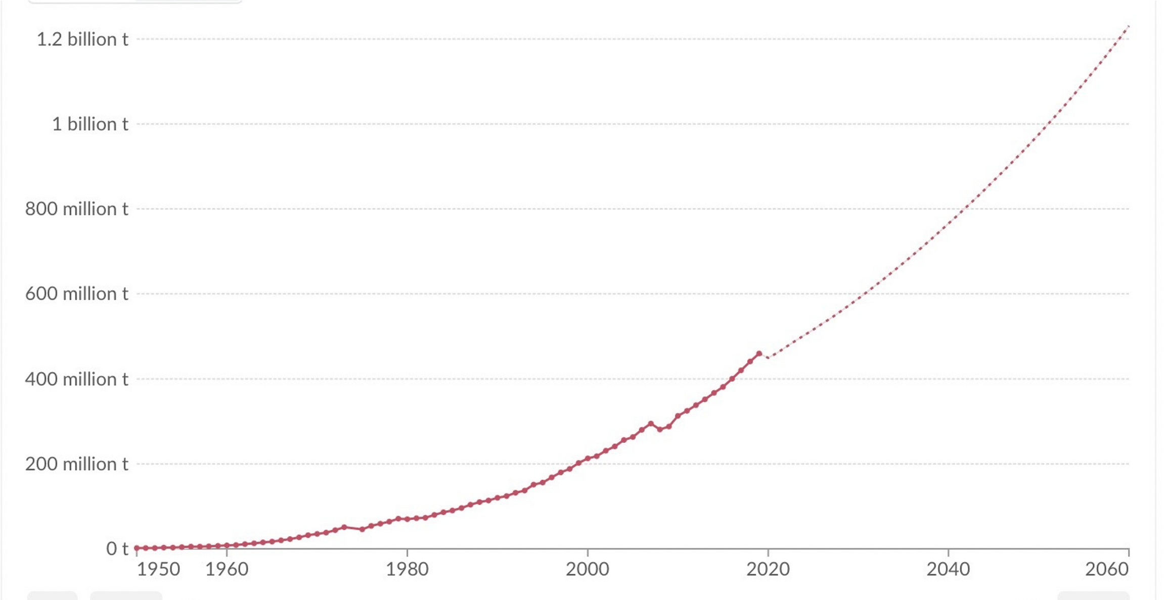

Slide 9

Our Solution
Product
EFFECTIVENESS
Benefits
End user a cardboard package that contains 28 capsules
Gym cafeterias a jar that can be refilled with the capsules
This can product can be very effective and shows great outcomes in reducing the plastic waste.
This product would benefit the user and making them buy it since it enhances their usability

Slide 10
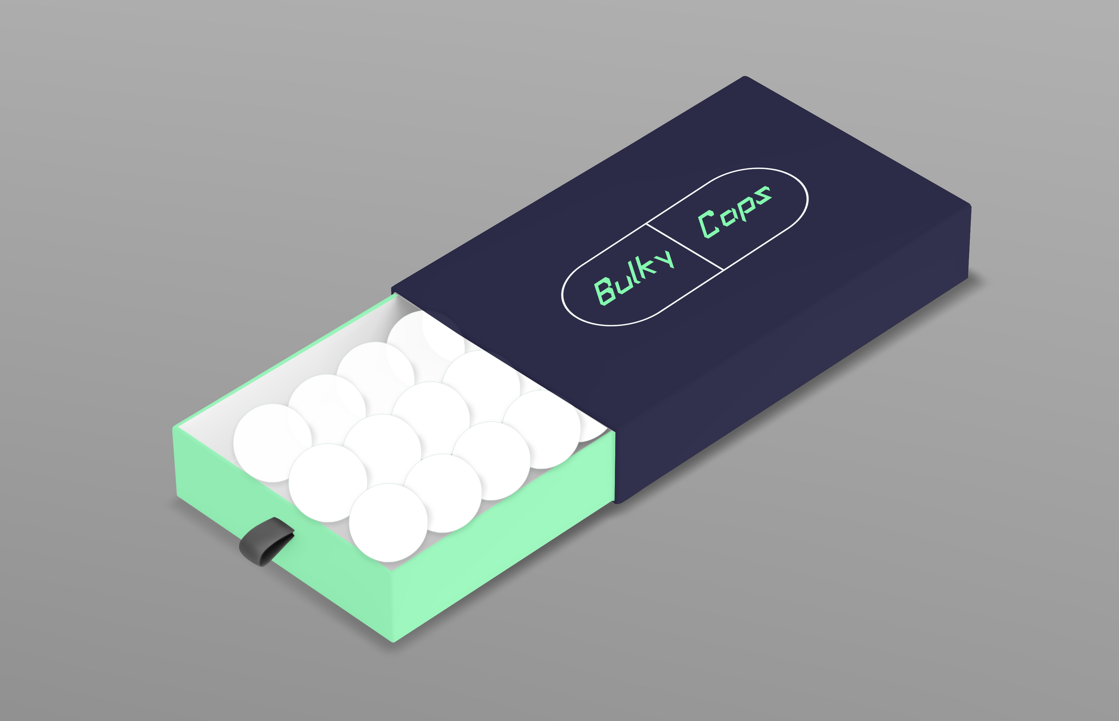

Slide 11
Strategies
Tam Sam Som
Marketing Growth
Segmentation

Slide 12
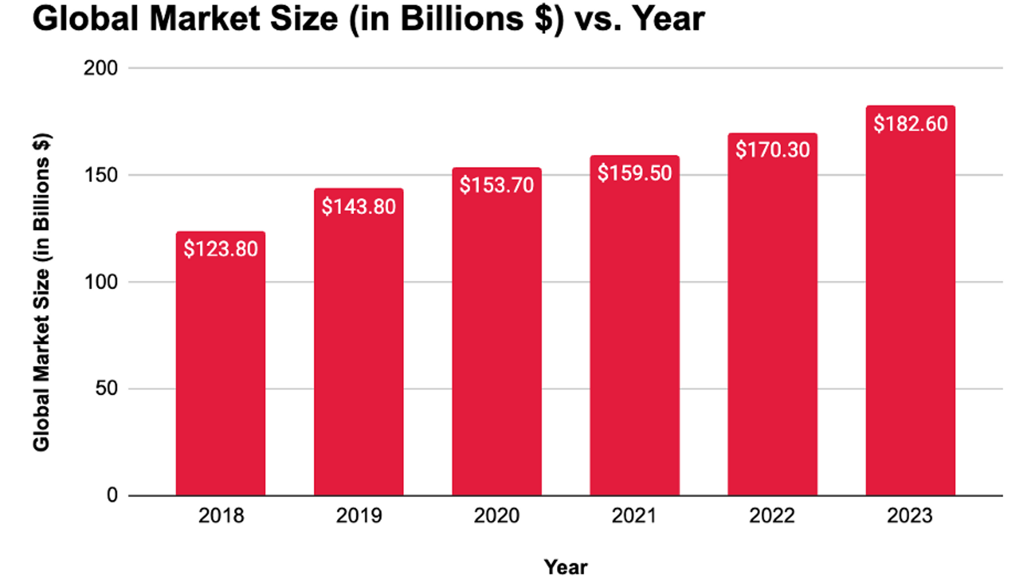

Slide 13
Revenue Model
B2B | B2C | REVENUE MODEL
Refilling plastic jars with supplemental capsules in cafeterias | Selling supplemental capsules in a cardboard package to enhance eco friendly packaging | For our revenue model we used two revenue streams in which they are refilling supplemental capsules in gym and users buying the capsules from supplement

Slide 14
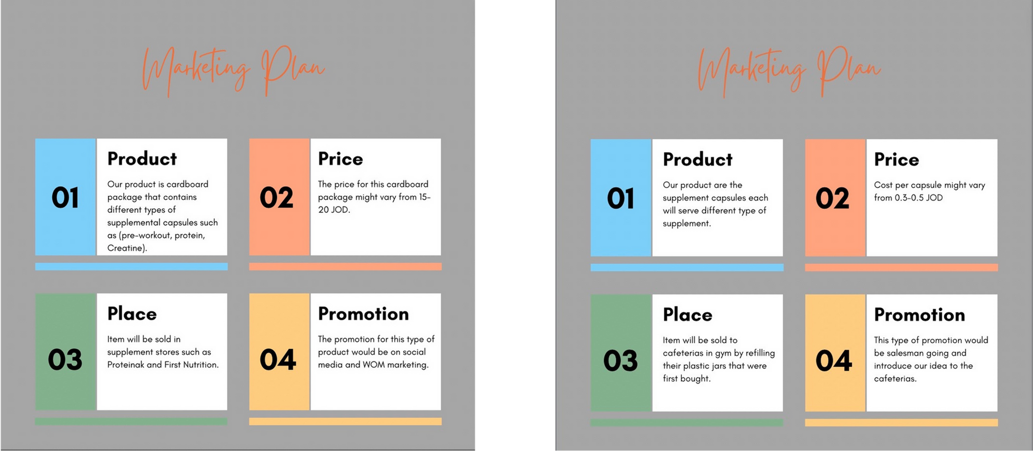
Marketing Mix

Slide 15
COMPETITIVE LANDSCAPE
COMPETITORS
USP
ADVANTAGE
The only supplemental product that is made of eco-friendly package
Direct Competitors:
Proteinak, Kabs Fit Factory
Indirect Competitors:
Protein Bars & Al Maraai Protein drink
Our product is positioned to enhance usability and reduces waste materials with a competitive price

Slide 16
Go-To market strategy
Pre launch
Launch
Post launch
Goal
How
Impact
Goal
How
Impact
Goal
How
Impact

Slide 17
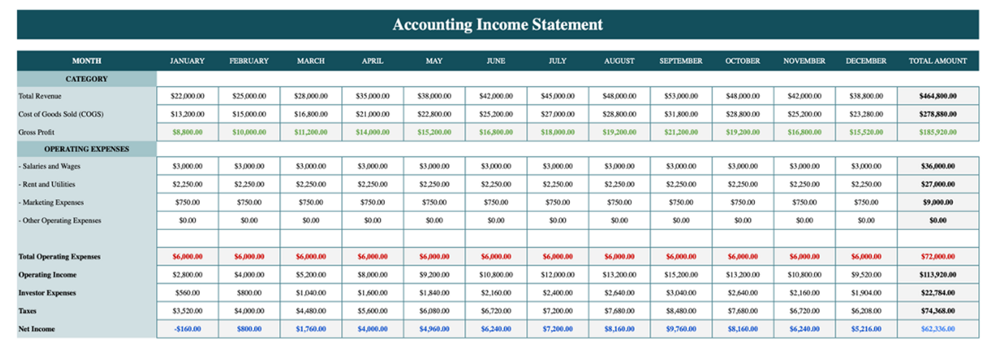
Income statement

Slide 18
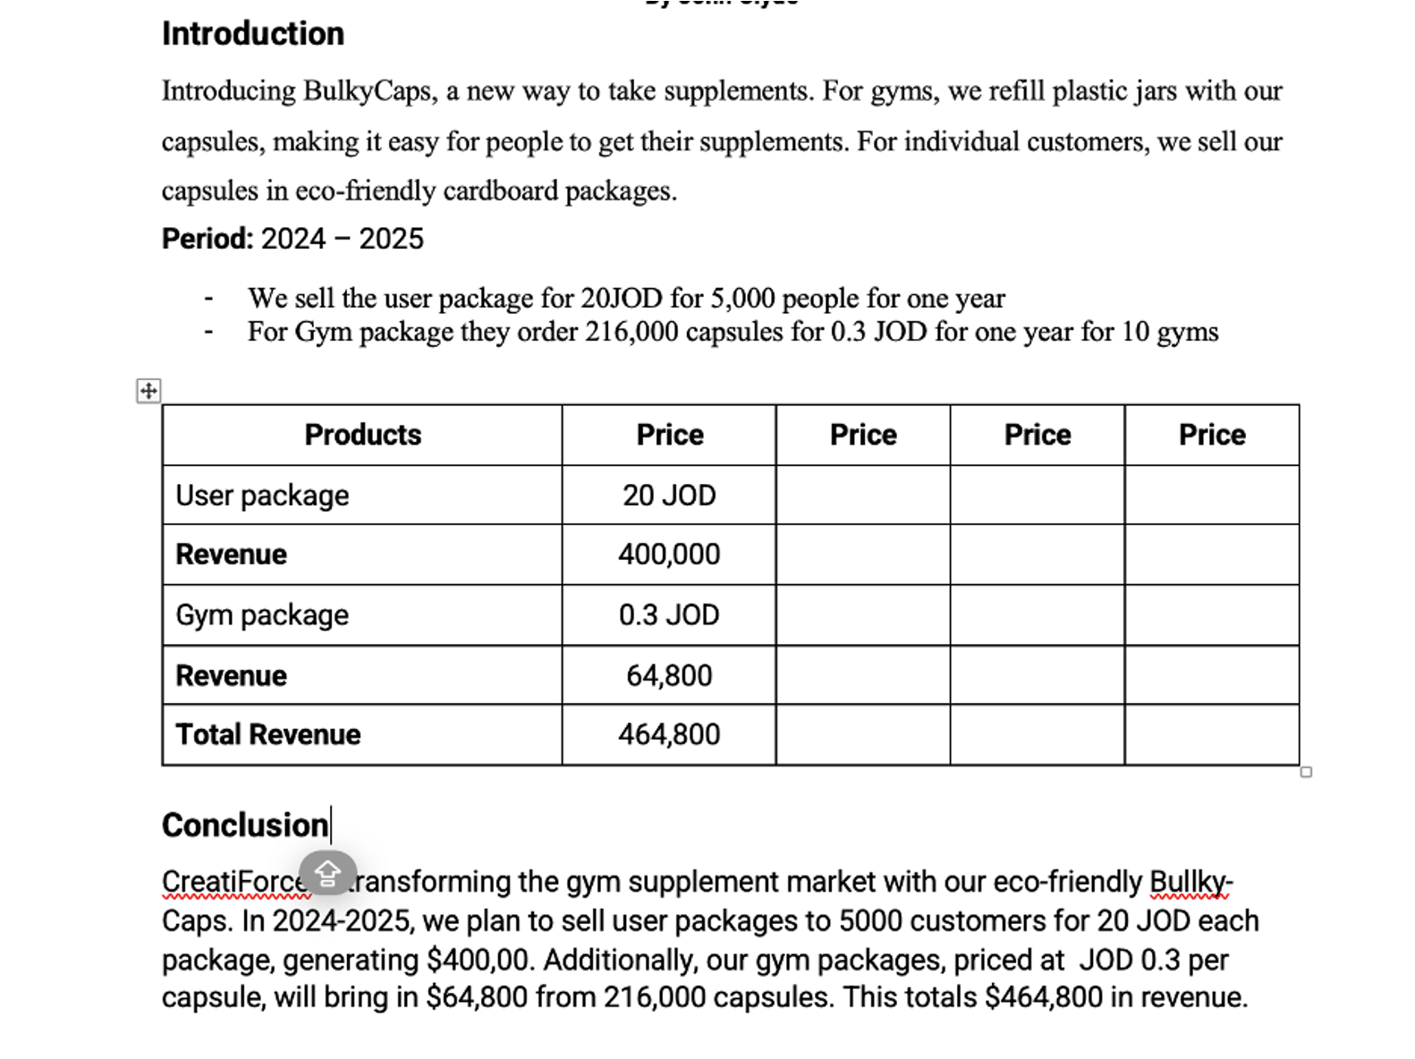

Slide 19
Break even point
32K
We need to sell 32K capsules to break even.

Slide 20

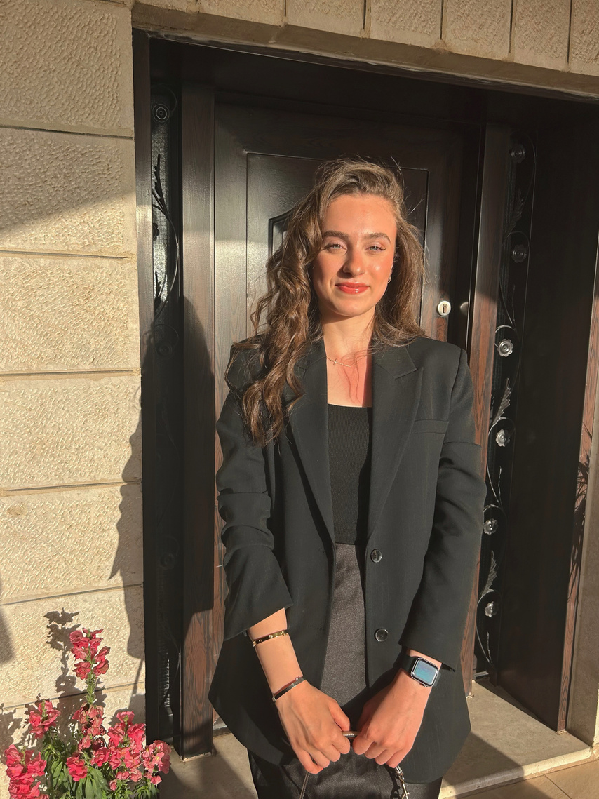

Our Team
Saif Haddad
Raghad Al Aranki
Kameel Al Namat

Slide 21



Our Team
Elias Fakhoury
Budoor Al Dahleh
Zaid Besani

Slide 22
THANK YOU
THANK YOU
THANK YOU

